Slide 2

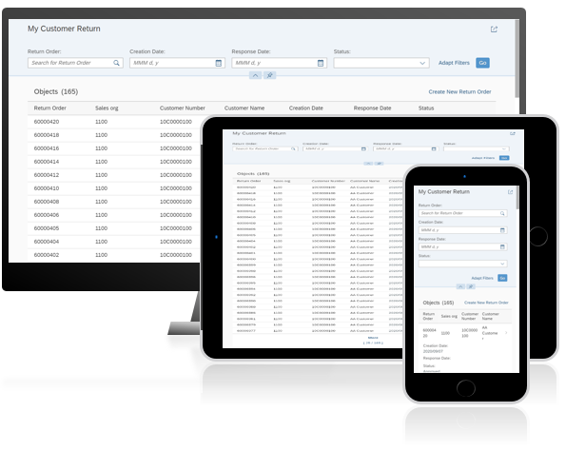
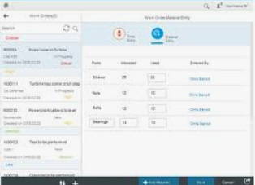

S/4HANA
UI5 Architecture
Fiori Shell
SAP Fiori UX
SAPUI5 Apps
Dispatcher
oData
SAP S/4HANA
ABAP
SAP S/4HANA Applications
Gateway
Transactional
CDS Views
HANA
SAP HANA Database
Database Tables
Notes:
Hello everyone, I am Sabrina. I will give you an introduction about SAPUI5 Architecture with S4HANA
From the architecture, we could get, with the simplified data model of S/4 Hana, odata services are genertated by using CDS views which resides at HANA database level. Fiori apps as the top layer, fetch all data from odata service provided by s/4 hana applications which makes user experience improve.
This time we deploy the fiori apps on SAP Cloud Platform which can accelerate integration across users’ value chain, simplify development of application extensions, and expand business value with an open ecosystem.

